Slide 1
Threats, Vulnerabilities and Risks – Where to Begin
Notes:
How many people do application risk assessments on their web apps?
How many always involve the business contact (not IT) in the risk assessment?
How many have been doing this for over five years?
This talk is aimed at beginners.
And how can you get your users and management to understand just what it is that they are risking when it comes to their web apps.
I’ll cover some techniques that have been successfully used by hundreds of companies in all industries and business sectors.

Slide 2

Poor Communication of Risk
Notes:
Not being able to communicate application risk to management and users is a tremendous risk in and of itself.
For example - The Challenger. It’s not that “management didn’t listen” – management wanted the mission to succeed as much as anyone – but the engineers didn’t communicate the risk well enough. Ed Tufte has an excellent analysis of this in one of his books.
The engineers were not able to put the risk in terms that management could clearly grasp within the amount of time that managers had alloted to make a decision.
Effective communication of Risk can help build in security.
You’ll be able to deploy your resources more effectively and efficiently
You’ll have a standard and consistent method and this means you can benchmark, track, and show that your efforts or working

Slide 3
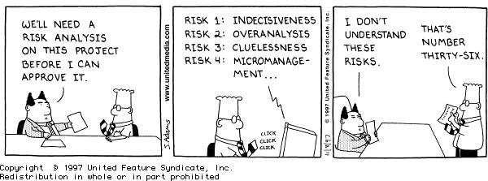
How to Communicate Risk?
Notes:
Application risk is not the same as project risk. I won’t discuss project risk today; that’s the risk that a project itself might not be successful.
Application risk is the risk that the application will not perform the desired business function, or that the application will perform an function detrimental to the business.

Slide 4
Managing risk (NIST)
Frame risk
Assess risk
Respond to risk
Monitor risk
Notes:
NIST risk management
A four part process
Framing risk is important – it defines how does your organization handle risk
Shameless plug for High Risk of Low Risk applications
But we won’t focus on that today
It’s usually set for you by your mgmt

Slide 5
Assess risk
Prepare for the assessment
Conduct the assessment
Communicate the results
Maintain the assessment over time
Notes:
Pretty straightforward, eh?
Cautionary notes
- Risk assessments are often not precise instruments of measure (uncertainty)
Risk assessments should not be overworked
By this I mean keep your assessment broader rather than deeper. Take off the blinders.
The first step is important – proper planning prevents poor performance

Slide 6
Management May Relate To:
Ensure Business Continuity
Calculate Risk For Critical Assets
Improve Security
Maintain Regulatory Compliance
Notes:
How your management and users can.
So let’s start by talking about things that everyone can understand
(bullet points)
This is not my methodology. This is not "Conrad's" way. I didn't create any of the stuff in this talk. But it's just like Algebra. Somebody else thought it up, and it just works. I've just seen it work over and over.
Just like your algebra teacher, I'm here to show you what can help solve some of your security communication problems. It's not the only way, but if what you're doing now isn't working, give it a try.
Important to remember that this process is not an audit.

Slide 7
Prepare for the assessment
Identify purpose & scope
What is your system trying to accomplish?
Must be aligned with a business objective
Allows you to focus on what Assets really need to be protected
Repeat: Pick objectives that are important to management
Notes:
Purpose –
Risk assessments address potential harm
what decisions will the ra support?
Usually supports decisions on risk mitigations, but could also affect decisions about disaster recovery and business continuity
Scope – be very sure you don’t bite off more than you can chew. Start small, if you haven’t done these before.
Stated definition must be aligned with a business objective
By starting here, instead of jumping rignt into threats and vulnerabilities, you'll focus on what actually needs to be protected and end up missing fewer threats and vulnerabilities.
Repeat: otherwise you will not be able to gain credibility

Slide 8

Example
Notes:
Illustrated example
What are we trying to accomplish here? What’s the objective?

Slide 9

Identify assumptions and constraints
Threats
Existing conditions
Notes:
what threat sources going to be considered? adversarial and non-adversarial, like accidents?
Generally you will want to consider both.
Existing conditions – are we constrained by an specific architecture or physical location, for instance?
The Wicked Witch of the West could be melted by water, yet there were buckets of the stuff all around her castle.

Slide 10
Identify assumptions and constraints
Orientation
Threat
Asset-effect
Vulnerability
Notes:
threat oriented (the risk that particular threats pose) or asset-effect oriented (the risk that identified assets are compromised) or
- this can also have the beneficial effect of requiring you to identify your valuable assets vulnerability oriented (the risk that identified vulnerabilities could be harmfully exploited)?
? What do you think
I strongly recommend focusing on asset-effect if you don’t know where to start
level of detail – may depend on size of system or even size of organization

Slide 11
Conduct the risk assessment
Identify or determine
Threat
Vulnerability
Effect
Likelihood
Risk
Notes:
Detecting a theme here?

Slide 12
Threats and Vulnerabilities
Threat ≠ Vulnerability
Threat Assessment ≠ Vulnerability Assessment ≠ Risk Assessment
Vulnerability Management ≠ Risk Management
Notes:
We need to establish some terms that you and your users can understand, and you can agree on common definitions.
Accountants figured this out a long time ago. for the most part, IBIT, EBDIT, NPV, IRR, etc, are well enough defined that they don't lead to misunderstandings about their meanings. "Risk" and "vulnerability" have not (yet) achieved such clarity
Just using the words “Threat”, “Vulnerability”, and especially “Risk” without defining them first is just asking for misunderstanding and a lack of effective communication.
(bullet points)
These three words mean three different things.

Slide 13

eCommerce example
Notes:
As we go through the steps, let’s think of an example of a simple ecommerce system to sell widgets online.
We already sell widgets in our store, through the mail, and over the phone.
What new risks might we encounter by selling online?
And what are we going to do about them?

Slide 14
Threat
Who or what might attack what asset, when, where, why, and how, and for what reason
Notes:
Can be deliberate or accidental.
Some may call "threats" triggers, that's OK
This graphic shows a deliberate threat against the bank’s cash on hand, etc
It is important not to overlook accidental attacks.
They happen all the time –
people forget to log off,
they send confidential reports to the wrong printer,
they assign the wrong role level to a user.

Slide 15

adversarial threat sources & events
Consider:
Capability
Intent
Targeting
Notes:
Assess adversary capability (can they?)
Assess adversary intent (often based on incentive, i.e., do they want to?)
could someone have something to gain? Does the system deal with cash?
Assess adversary targeting (is it you?)
multiple threat sources can initiate a single threat event or any of multiple threat events.
to keep this manageable, the org can classify them by how an event affects one of an organization's concerns (Will it have a negative financial effect? Will it effect reputation? Will it compromise safety? etc).
? What do you think are adversarial sources for our ecommerce?
Adversarial threat events include
?
create attack tools or conduct an attack
Deliver malicious capabilities.
Non-adversarial threat events
-----------------------------------------------------------------------------------------------
If you were at DerbyCon, you saw some pretty involved threat modeling but
(next slide)

Slide 16
Adversarial Threat Sources
Threat Source | In Scope | Capability | Intent | Targeting
Insider attack | Yes | High | High | High
External individual attack | Yes | Medium | Medium | Medium
Other organization attack | Yes | Medium | Medium | High
Notes:
An example of how this is documented NIST style
Simple. Communicates at a glance.
If you haven’t done this before, try it a few times before buying a $500,000 software package

Slide 17
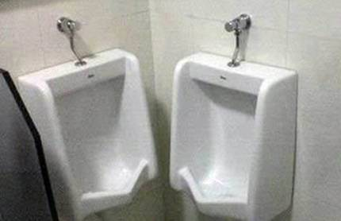
Identify Non-adversarial threat sources & events
Accidents, acts of God, etc
Notes:
For relevant non-adversarial threat sources:
Assess the degree of effects from threat sources , from minor to horrible (use your org’s nomenclature)
?
Accidental: user or administrator
Somebody leaves an confidential report at the coffee bar.
Database not backed up properly
Structural: failure of equipment, environmental controls, or software
The A/C goes out, or the roof leaks, or the "leap second" that caused so many servers to go crazy last summer.
Environmental: storms, earthquakes, sunspots, loss of electrical supply

Slide 18
Identification of Threat Events
Threat Event | Threat Source | Relevance
Credit card numbers released | Individual hacker | High
Slow response time | Poor database maintenance | Medium
Slow response time | Poor ISP contract terms | Low
Notes:
Just write them down. Again. Keep it Simple.
One reason it is simple is because the purpose of the assessment is to support executive decision.

Slide 19
Vulnerability
Something a threat could exploit
Even if it’s already controlled – the control could fail
Notes:
Don’t assume that just because a control is in place means it is not a vulnerability
You may end up needing multiple controls for a given vulnerability, as we will see later

Slide 20
Threats And Vulnerabilities
An executed Threat against a Vulnerability is an Attack
Notes:
The consequence of this definition is that you
don’t have to worry about threats against vulnerabilities that you don’t have,
Or vulnerabilities for which there is no credible threat.
Seems obvious, but sometimes people get lost in the risk assessment process and forget.
Or they just follow some list of vulnerabilities generated by a tool or published on the internet.

Slide 21
No Input Validation
Embezzlers
Accidental Input Error
Bots
Notes:
A given vulnerability can be exploited by multiple threats
(diagram)

Slide 22
Embezzler
XSS
CSRF
SQLi
Notes:
And a given threat can exploit multiple vulnerabilities
That same embezzler can take advantage of XSS, sql I, csrf vulnerabilities in your web app.

Slide 23
Example
Threat
Vulnerability
Effect
Likelihood
Uncertainty
Notes:
Illustrated example
? Threat - dog
? Vuln – hole in fence
? Effect – you get bit in leg
? Likelihood – ? Has the dog bitten anyone before? Can it fit through the hole?
? Uncertainty – these are all uncertain

Slide 24

Try Not to Assume Something Cannot Happen
Notes:
As long as there is a threat and an associated vulnerability, there could be an attack.
But also, at the same time, try not to get carried away about jet engines falling through your roof.
Use real world events as your guide.
For web apps, be sure you understand what the current security issues for web apps and browsers are
Motivation is one of the primary factors in determining what might actually happen, just as it is in this video clip.
There was a vulnerability in that fence, and the dog was motivated to execute a successful attack on it.

Slide 25
Effect And Likelihood
Effect
Can be Good or Bad
Not the same as Risk!
Affects Information
Integrity
Confidentiality
Availability
Likelihood = Probability
Notes:
Effect on the business objectives that we defined earlier.
Good or Bad - We will focus on the Bad kind here
For web apps, usually affects information
Integrity – are the data right, can they be relied upon?
Confidentiality –
Availability – will the data be there when you need them?
There can be other affects, such as bad publicity; include them if they are material.

Slide 26
Determine likelihood
Adversarial
initiation
Non-adversarial
occurrence
Notes:
Likelihood:– not used in the strict or statistical sense of the term. risk assessors assign a score (or likelihood assessment) based on available evidence, experience, and expert judgment.
First, what’s the likelihood the threat event will happen?
Second, what’s the likelihood the threat event will cause harm? You don’t have to worry about threat events for vulns you don’t have.
Then, combine the two for overall likelihood.
? OWASP top ten can give you an idea of incidence of web app problems
? We could review blogs, industry reports, etc
Adversarial – likelihood of initiation:
? Historical data, monitoring logs, incident reports
for non-adversarial – likelihood of occurance,
? Historical frequency of occurrence may be of greater use here

Slide 27
Estimating Effect And Likelihood - Ask Questions
Could the information be manipulated for personal gain?
Could business decisions be affected?
Could you fail to take action: process orders, pay invoices?
Can you discover the problem?
How much information loss would make a material difference?
Notes:
Now we have to estimate effect and likelihood. You start by asking questions.
This is the most critical thing I will mention today – these questions, and others, have to make sense to the parties involved, and have to get to the real basis of how the application is used.
I’m going to read them because they are so important.
Personal gain – the motivation issue I mentioned before. The “Willie Sutton” principle.
Can you discover the problem – this affects the effect and likelihood - things people can get away with may be more likely.

Slide 28
Estimating Effect and Likelihood – More Questions
Would disclosure lead to public embarrassment?
Is there a difference between internal and external disclosure?
Can you permanently lose business?
Could there be fines or penalties?
Do non-employees have access to the information?
Notes:
As you discuss these questions with the support staff AND the users, you’ll get a handle on what’s important and what needs to protected the most.

Slide 29
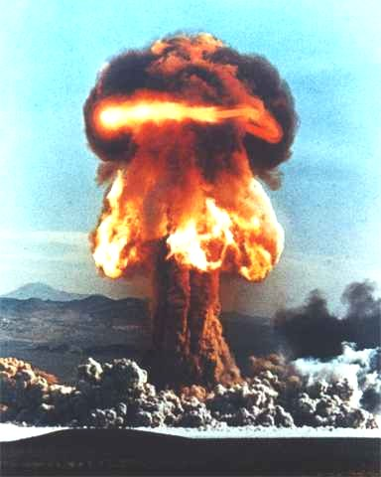
Determine effect (harm)
To operations
To assets
To individuals
To other organizations
Notes:
Identify adverse impacts of each threat event/vulnerability combination
Harm to Operations
? shipments disrupted, failure to meet contractual obligations , PCI DSS
Harm to Assets
? Loss of information or network
Harm to Individuals
? Identify theft
Harm to other organizations
? Failure to meet obligations
damage to trust
How bad could these be
? In some cases, significant

Slide 30

Determine risk
Generally, the combination of likelihood of the event and its harmful effect
Notes:
The formula for your organization would have been determined back in the “frame risk” part.
You can start with the general definition and refine it as you mature.
Now we will define Risk.
Often the effect and/or the likelihood is also called "risk", which is probably the most common confusion I see. Note that with this nomenclature, you don't "identify risks", you calculate risk: for instance, hi, med, or lo. You identify threats and vulnerabilties.

Slide 31
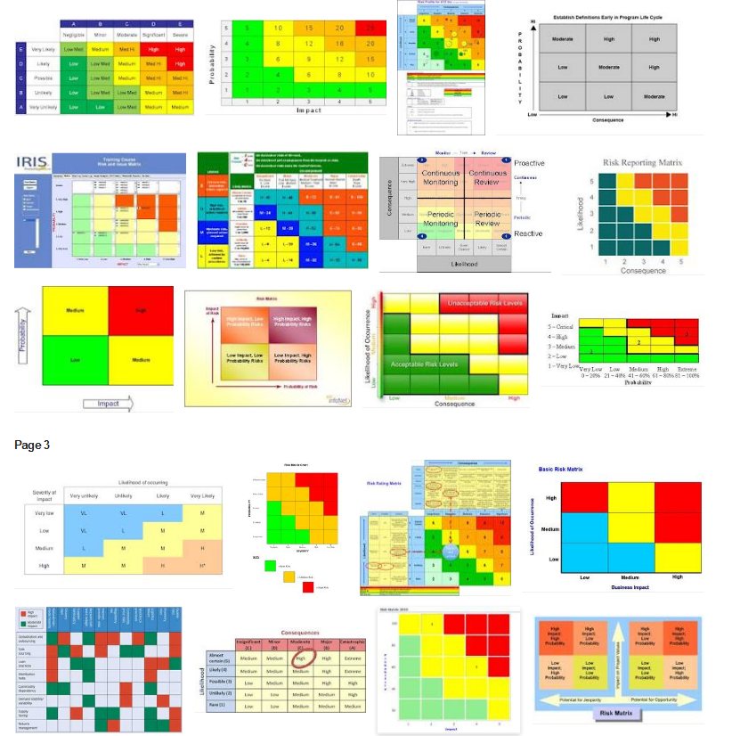
Risk Charts
Notes:
Once you have your effects and probabilities estimated, you can plot them in a Risk chart.
These charts have their limitations, but they are very popular (this is a small section from a google result) and they are great for risk beginners.
How many people use these charts? Has anyone stopped using them?
(Describe the chart)

Slide 32
Med Risk
High Risk
High Risk
Effect
Low Risk
Med Risk
High Risk
Low Risk
Low Risk
Med Risk
Likelihood

Slide 33
Success!
Now we have a measurement of Risk that management can relate to
Management’s job to decide what level of Risk they are willing to live with
This will define what Threats and Vulnerabilities need to be addressed with Controls
Notes:
A measurement of Risk in terms of how it can affect their business
What level of risk will they live with – that’s where you draw the line and work the items above that line
Document the items “below the line” also to make future reviews easier. And Audits.
quick quiz: do threats increase risk? do vulnerabilities increase risk? no. remember: it takes three to tango: threats, by themselves, do not increase risk
vulnerabilities, by themselves, do not increase risk
only threats that exploit vulnerabilities that have an effect increase risk. Unfortunately, there are usually a lot of those.

Slide 34
Managing risk (NIST)
Frame risk
Assess risk
Respond to risk
Monitor risk
Notes:
Although not part of the risk assessment step,
We’ll talk about the output of the risk assessment.

Slide 35

Respond to risk
What are we going to do with this information?
Notes:
Keep in mind the objective of the assessment as you perform it:
provide a consistent response to risk in accordance with the organizational risk frame that we discussed earlier

Slide 36
Identify alternative courses of action
Accept
Mitigate
Share or transfer
Avoid
Bring it on!
Shields up!
Not me!
Just say no
Notes:
Identify alternative courses of action for responding to risks determined during the risk assessment;
accept, avoid, mitigate, share or transfer risk
Share or transfer risk It is important to note that risk transfer reduces neither the likelihood of harmful events occurring nor the consequences in terms of harm to organizational operations and assets, individuals, or other organizations
Evaluating the alternative courses of action;
Decide on the appropriate courses of action consistent with organizational risk tolerance;
Implementing risk responses based on selected courses of action.

Slide 37

Monitor risk
Ensure accountability
Periodic review
Notes:
If you decide to implement mitigating controls, you must assign responsibility. If no one is accountable, the control is almost certain to fail when needed.
Controls should also have a way to be tested for efficacy, and tested periodically. Untested controls have a way of failing when you need them.
Identify changes which affect risk levels.
Verify compliance with organizational missions/business functions, federal legislation, directives, regulations, policies, standards, etc

Slide 38

Get Management Sign-off
Notes:
Mgmt must agree to the risks, responses, and ongoing responsibilities.
Otherwise you won’t have much to show for your efforts

Slide 39
Controls
There is no bank that cannot be robbed
Either lower the magnitude of the Effect or reduce the likelihood of Attack
It is critical to assign responsibility and tests for all controls implemented
Notes:
(2) In order to lower risk –
(3) If no one is responsible for a control, it won’t happen. If it’s not tested, it may fail when needed.

Slide 40
Communicate results to key personnel
Communicate results to decision makers to support risk responses.
Notes:
Communicate ra results with your now well-documented assessment

Slide 41

Documentation
For the sake of audit and future reviews, document controls not implemented, too
Hierarchical information
Notes:
Document your risk assessment – the whole process
From identifying the business objective
through how effect and likelihood were determined
To controls, their responsibility and test procedures

Slide 42
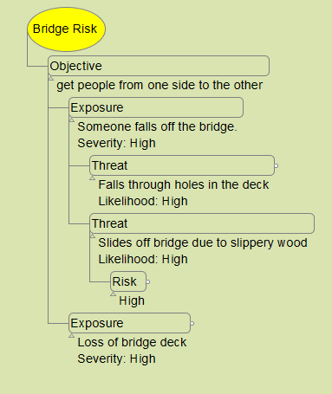
Documentation – Mind Map
Notes:
I like to use a mind mapping tool for gathering the information
Makes it easy to build hierarchies as the info comes in
Then flatten out the info for management
Management usually doesn’t like hierarchies for anything other than the org chart. They really like it for the org chart, though.

Slide 43
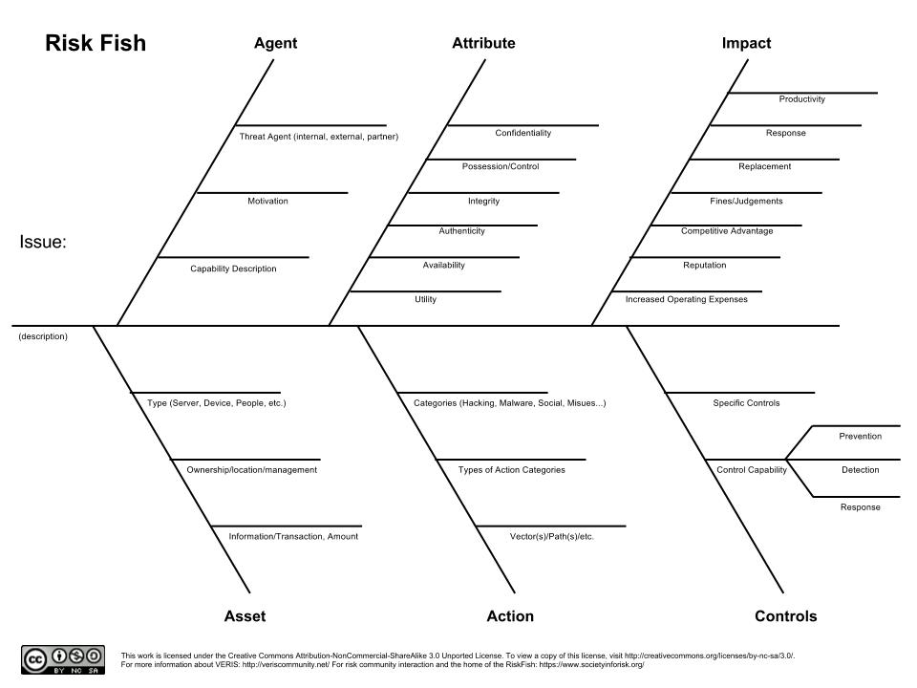
Documentation – Fish Diagram
Notes:
This is one that is fairly new to me
Shows hierarchy. Good if you already use ishikawas in your company.

Slide 44
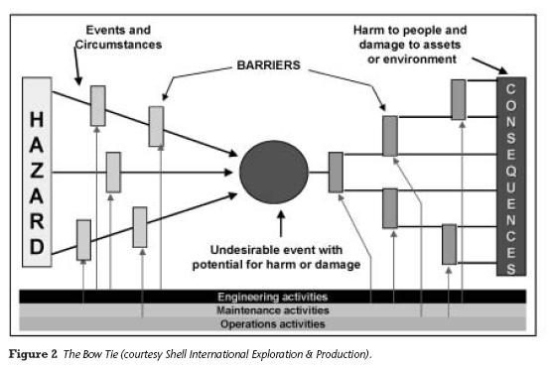
Documentation – Risk Bow Tie
Notes:
What you can work your way up to
I consider this is a rather advanced tool.

Slide 45
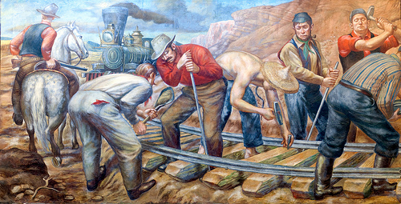
Maintain assessment over time
Ongoing monitoring of risk factors that contribute to changes in risk
Update existing assessment using the results from monitoring of risk factors
Notes:
This is where careful documentation of the process pays off. A year or two from now, the next review and update can simply pick up the previous assessment and update it.
This saves a tremendous amount of time.
It’s best if you have ongoing monitoring of risk factors that contribute to changes in risk
monitor the status of external threats.
monitor new vulnerabilities discovered.
Update existing assessment using the results from monitoring of risk factors.

Slide 46
Summary
Determine what business functions the application is expected to perform (Objective)
Determine what would happen if the application failed to perform that function (Effect)
Determine what could cause such failures (Threats & Vulnerabilities)
Estimate how likely a given cause would be (Likelihood)
Risk = Effect * Likelihood
Apply Controls to lower Risk to an acceptable level
Notes:
Steps 2 and 3 will often be worked together and go back and forth as you work through your questions

Slide 47
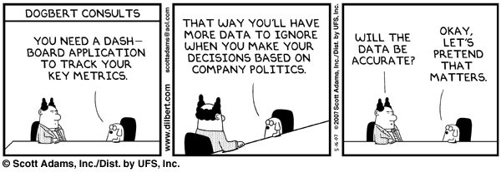
What are you going to do with this information?
Notes:
Finally, What are you going to do with this information?
First, it’s best to do a risk assessment before beginning work.
Helps avoid finger-pointing later.

Slide 48
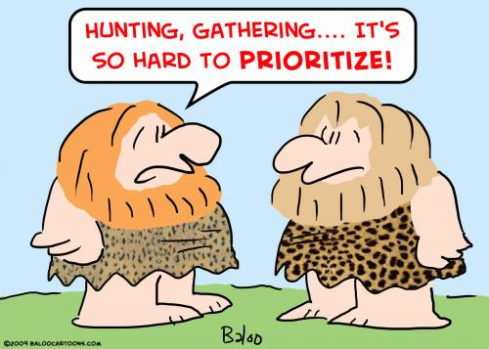
What are you going to do with this information?
Notes:
We all have limited resources
Rank your applications so you know where to start
Maximize benefits – minimize costs – managers like to hear that

Slide 49
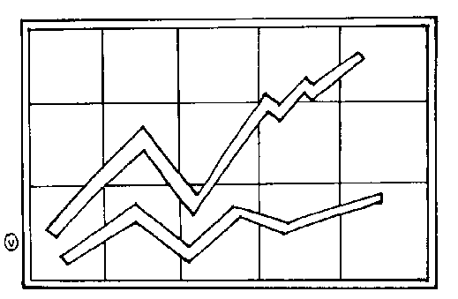
What are you going to do with this information?
Notes:
Using a standard, consistent method will allow you to establish benchmarks and metrics
over time
Managers like this also

Slide 50

What are you going to do with this information?
Notes:
Avoid “Dog Show Quality”
Compliance is not Security

Slide 51




What can go wrong?
Notes:
Multiple threat sources and vulnerabilities can lead to a given threat event. This is why defense in depth – multiple controls against a given threat event or a given vulnerability or a given asset – is a good idea if the potential harm is high
And remember accountability is crucial

Slide 52

What can go right?
Notes:
The NIST, and other risk management frameworks,
allow you to develop a repeatable, documentable process for assessing risk and responding to it appropriately.
The process fits *your* organization.
You can plan actions to avoid problems.
You avoid a “compliance checkoff” mentality that doesn’t really improve security.
You avoid reinventing the wheel.
You establish consistency.
You can establish benchmarks and metrics around risk
You become more efficient.
And not least, You raise security awareness in your organization.
? Any reason not to?

